Slide 1
The Transport Layer
Lecturer: Ngo Huy Bien
Software Engineering Department
Faculty of Information Technology
VNUHCM - University of Science
Ho Chi Minh City, Vietnam
nhbien@fit.hcmus.edu.vn

Slide 2
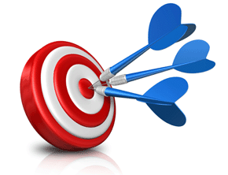
Objectives

Slide 3

Contents
Multiplexing and Demultiplexing
Ports
Transmission Control Protocol (TCP)
User Datagram Protocol (UDP)

Slide 4

References
Andrew S. Tanenbaum and David J. Wetherall (2021). Computer Networks. Pearson Education.
James F. Kurose and Keith W. Ross (2021). Computer Networking: A Top-Down Approach. Pearson.

Slide 5
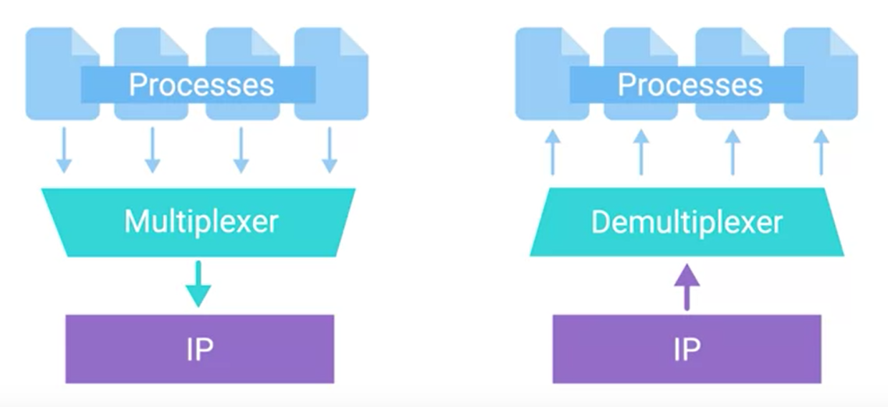
Multiplexing and Demultiplexing
Multiplexing: It means that nodes on the network have the ability to direct traffic toward many different receiving services.
Demultiplexing: Taking traffic that's all aimed at the same node and delivering it to the proper receiving service.

Slide 6
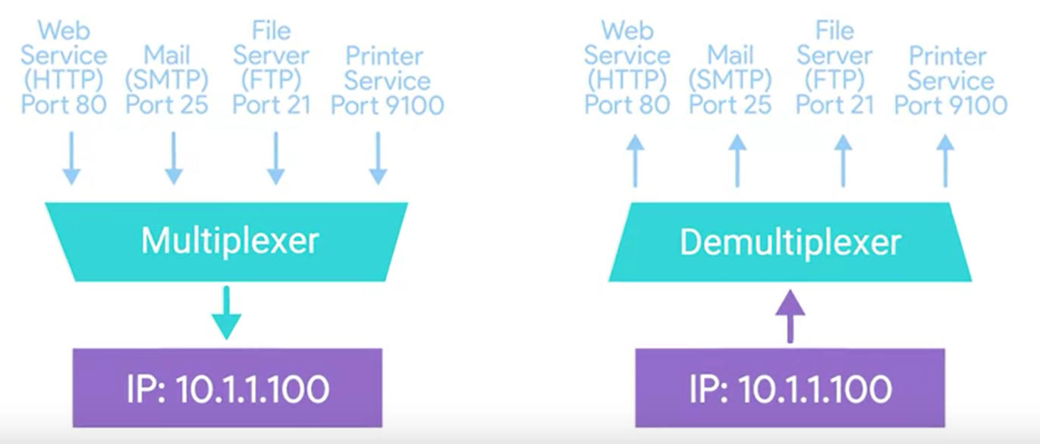
Ports
Port: It is a 16-bit number that's used to direct traffic to specific services running on a networked computer.

Slide 7
Port Categories
Since a 16-bit number identifies ports, there can be 65,535 of them. Given the number of ports available, they have been divided into three categories by the Internet Assigned Numbers Authority (IANA).
System Ports are identified as ports 1 through 1023. System ports are reserved for common applications like FTP (port 21) and Telnet over TLS/SSL (port 992). Many still are not assigned. Note: Modern operating systems do not use system ports for outbound traffic.
User Ports are identified as ports 1024 through 49151. Vendors register user ports for their specific server applications. The IANA has officially registered some but not all of them.
Ephemeral Ports (Dynamic or Private Ports) are identified as ports 49152 through 65535. Ephemeral ports are used as temporary ports for private transfers. Only clients use ephemeral ports.

Slide 8
TCP Segment
TCP segment: A payload section of an IP datagram made up of a TCP header and a data section.
Sequence number: A 32-bit number that's used to keep track of where in a sequence of TCP segments this one is expected to be.
Data offset field: The number of the next expected segment in a TCP packet/datagram.
TCP checksum: A mechanism that makes sure that no data is lost or corrupted during a transfer.
Urgent pointer field: A field used in conjunction with one of the TCP control flags to point out particular segments that might be more important than others.

Slide 9
TCP Control Flags
URG flag: One of the TCP control flags. URG is short for urgent. A value of one here indicates that the segment is considered urgent and that the urgent pointer field has more data about this.
ACK flag: One of the TCP control flags. ACK is short for acknowledge. A value of one in this field means that the acknowledgment number field should be examined.
PSH flag: One of the TCP control flags. PSH is short for push. This flag means that the transmitting device wants the receiving device to push currently buffered data to the application on the receiving end as soon as possible.
RST flag: One of the TCP control flags. RST is short for reset. This flag means that one of the sides in a TCP connection hasn't been able to properly recover from a series of missing or malformed segments.
FIN flag: One of the TCP control flags. FIN is short for finish. When this flag is set to one, it means the transmitting computer doesn't have any more data to send and the connection can be closed.

Slide 10
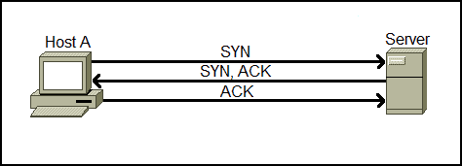
Three-way Handshake
Handshake: A way for two devices to ensure that they're speaking the same protocol and will be able to understand each other.
Since TCP is a connection-oriented protocol, a connection needs to be established before two devices can communicate.
TCP uses a process called three-way handshake to negotiate the sequence and acknowledgment fields and start the session.

Slide 11
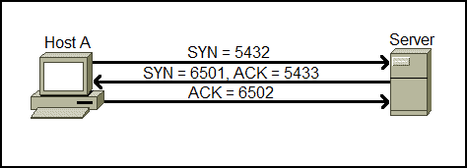
Three-way Handshake Example
Host A initiates the connection by sending the TCP SYN packet to the destination host. The packet contains the random sequence number (e.g. 5432) which marks the beginning of the sequence numbers for data that the Host A will transmit.
The Server receives the packet and responds with its own sequence number. The response also includes the acknowledgment number, which is Host A’s sequence number incremented by 1 (in our case, that would be 5433).
Host A acknowledges the response of the Server by sending the acknowledgment number, which is the Server’s sequence number incremented by 1.

Slide 12
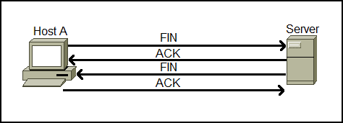
Four-way Handshake
After the data transmission process is finished, TCP will terminate the connection between two endpoints.
The client application that wants to close the connection sends a TCP segment with the FIN (Finished) flag set to 1.
The server receives the TCP segment and acknowledges it with the ACK segment.
Server sends its own TCP segment with the FIN flag set to 1 to the client in order to terminate the connection.
The client acknowledges the server’s FIN segment and closes the connection.

Slide 13
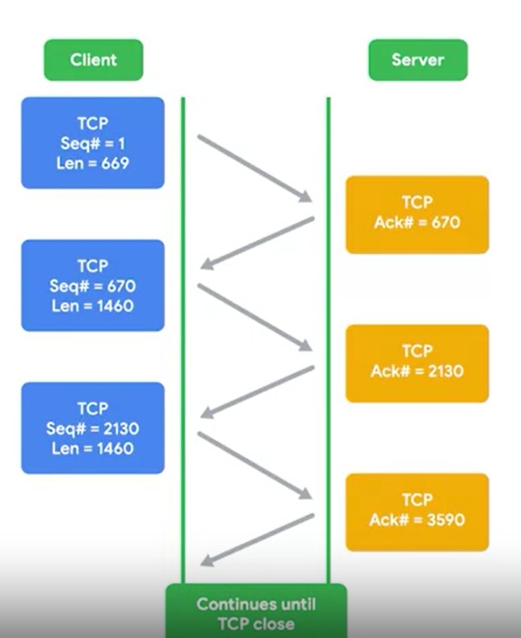
TCP Segment Transmission

Slide 14
Transmission Control Protocol
Transmission Control Protocol (TCP) is a communications standard that enables application programs and computing devices to exchange messages over a network.
It is designed to send packets across the internet and ensure the successful delivery of data and messages over networks.
The TCP protocol sends acknowledgments between the service and client to show that sent data was received.
Then, it uses checksum verification to confirm that the received data matches what was sent.

Slide 15
Transmission Control Protocol
https://www.ibm.com/docs/en/aix/7.3?topic=protocols-transmission-control-protocol
TCP uses Internet Protocol, the underlying protocol, to transport datagrams, and supports the block transmission of a continuous stream of datagrams between process ports.
TCP provides reliable message delivery.
TCP ensures that data is not damaged, lost, duplicated, or delivered out of order to a receiving process. This assurance of transport reliability keeps applications programmers from having to build communications safeguards into their software.

Slide 16
TCP Sockets (Dependent on OS)
Instantiation: The actual implementation of something defined elsewhere.
A socket is an active port used by a service.
Once a socket is activated, a client can send and receive data through it.

Slide 17
TCP Socket States
Listen: It means that a TCP socket is ready and listening for incoming connections
SYN_SENT: A TCP socket state that means that a synchronization request has been sent, but the connection hasn't been established yet.
SYN_RECEIVED: A TCP socket state that means that a socket previously in a listener state, has received a synchronization request and sent a SYN_ACK back.
ESTABLISHED: Status indicating that the TCP connection is in working order, and both sides are free to send each other data.
FIN_WAIT: A TCP socket state indicating that a FIN has been sent, but the corresponding ACK from the other end hasn't been received yet.
CLOSE_WAIT: A connection state that indicates that the connection has been closed at the TCP layer, but that the application that opened the socket hasn't released its hold on the socket yet.
CLOSE: A connection state that indicates that the connection has been fully terminated, and that no further communication is possible.

Slide 18
Connection-Oriented Protocols
Connection-oriented protocol: A data-transmission protocol that establishes a connection at the transport layer, and uses this to ensure that all data has been properly transmitted.

Slide 19
Connectionless Protocols
Connectionless protocol: A data-transmission protocol that allows data to be exchanged without an established connection at the transport layer.
The most common of these is known as UDP, or User Datagram Protocol

Slide 20
User Datagram Protocol
User Datagram Protocol (UDP): A transfer protocol that does not rely on connections.
This protocol does not support the concept of an acknowledgement.
With UDP, you just set a destination port and send the data packet.

Slide 21
UDP delivery is not guaranteed
https://www.ibm.com/docs/en/aix/7.3?topic=protocols-user-datagram-protocol
UDP provides the same connectionless message delivery as IP.
It offers no assurance of datagram delivery or duplication protection.
However, UDP does allow the sender to specify source and destination port numbers for the message and calculates a checksum of both the data and header.

Slide 22
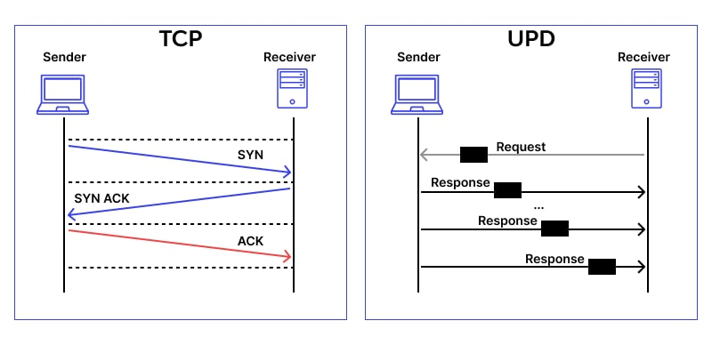
TCP vs. UDP
A TCP session:
Client: Hello.
Server: Okay. Hello.
Client: Okay. Here is my question.
Server: Okay. Server: Here is your answer
Client: Okay.
Client: Bye.
Server: Gotcha. Bye yourself.
Client: Okay.
A UDP transaction:
Client: Here's my question.
Server: Here's the answer.

Slide 23
TCP vs. UDP Detail
 | TCP | UDP
Connection Type | Connection-oriented — The device must establish a connection before transmitting data (handshake included) and close the connection after transmission. | Connectionless — No connection and no handshake are required to send data.
Reliability | Reliable — Data packet delivery is guaranteed. | Unreliable — Datagrams delivery isn’t guaranteed.
Communication Information Type | Stateful —The client and the server keep the information about the session. | Stateless — The server doesn’t keep any information about the session.
Header Size | Variable — 20-60 bytes header length. | Fixed — 8 bytes.
Speed | Slower than UDP as it follows many steps to ensure accuracy. | Faster than TCP as it’s a much simpler protocol.
Sequence | All packets are delivered to the recipient in a specific order. | Datagrams are delivered in no specific order. If it’s required a kind of order, it has to be managed by the application.
Broadcast Support | No broadcast or multicast are supported. | Broadcast and multicast are supported in addition to unicast.
Error Detection Mechanism | Extensive error detection provided: Flow control. Congestion control. Acknowledgment of data. | Basic error detection provided: Checksums.
Overhead | Resource intensive. | Lightweight.
Protocols | HTTP, HTTPs, FTP, SMTP, and Telnet. | DNS, DHCP, TFTP, SNMP, RIP, and VoIP.
Applications | Web browsing. File transfer. Email (SMTP, IMAP/POP) | VPN. Video and music streaming. Online games, multiplayer games. Live broadcasts and video conferencing. Domain name system (DNS) queries. Voice over IP (VoIP).

Slide 24
TCP and Unicast
TCP is a connection-oriented protocol that implies a connection between two hosts (specified by IP addresses) and one process on each host (specified by port numbers).

Slide 25
UDP and Broadcast and Multicast
Broadcasting and multicasting only apply to UDP.

Slide 26
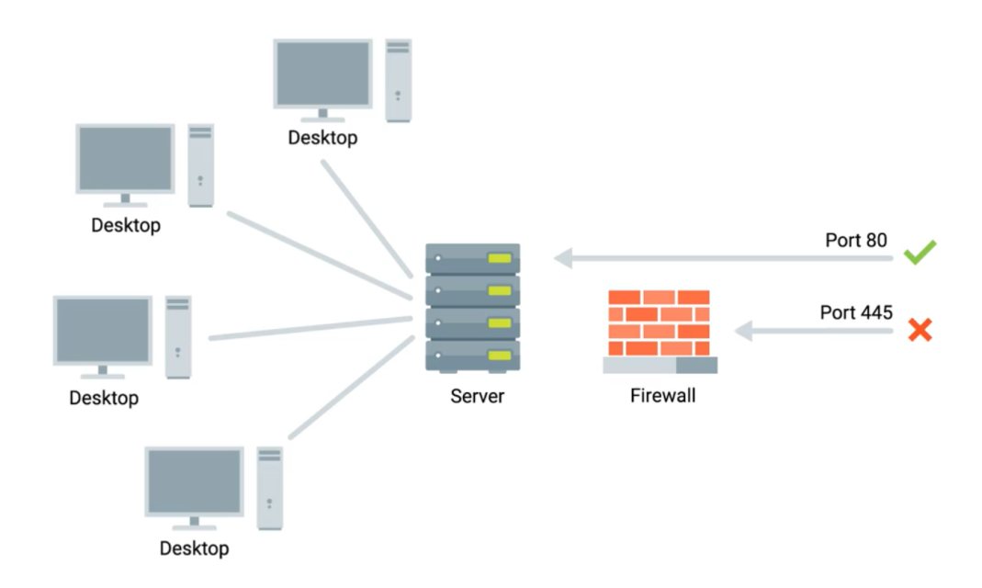
Firewalls
Ports allow services to send data to your computer but can also send malware into a client program.
Malicious actors might also use port scanning to search for open and unsecured ports or to find weak points in your network security.
To protect your network, you should use a firewall to secure your ports and only open sockets as needed.
Firewall: It is a device that blocks or allows traffic based on established rules.

Slide 27


Slide 28
Transport Layer Goal
The ultimate goal of the transport layer is to provide efficient, reliable, and cost-effective data transmission service to its users, normally processes in the application layer.
To achieve this, the transport layer makes use of the services provided by the network layer.
The software and/or hardware within the transport layer that does the work is called the transport entity.
The transport entity can be located in the operating system kernel, in a library package bound into network applications, in a separate user process, or even on the network interface card. The first two options are most common on the Internet.

Slide 29
Transport Service Types
Just as there are two types of network service, connection-oriented and connectionless, there are also two types of transport service.
The connection-oriented transport service is similar to the connection-oriented network service in many ways.
In both cases, connections have three phases: establishment, data transfer, and release.
Addressing and flow control are also similar in both layers.
Furthermore, the connectionless transport service is also very similar to the connectionless network service.

Slide 30
Transport vs. Network Service (I)
The transport code runs entirely on the users’ machines, but the network layer mostly runs on the routers, which are operated by the carrier (at least for a wide area network).
What happens if the network layer offers inadequate service? What if it frequently loses packets? What happens if routers crash from time to time?
The users have no real control over the network layer, so they cannot solve the problem of poor service by using better routers or putting more error handling in the data link layer because they don’t own the routers.
The only possibility is to put on top of the network layer another layer that improves the quality of the service.

Slide 31
Transport vs. Network Service (II)
Furthermore, the transport primitives can be implemented as calls to library procedures to make them independent of the network primitives.
Hiding the network service behind a set of transport service primitives ensures that changing the network merely requires replacing one set of library procedures with another one that does the same thing with a different underlying service.

Slide 32
Transport Service Primitives
To allow users to access the transport service, the transport layer must provide some operations to application programs, that is, a transport service interface.
Primitive | Packet sent | Meaning
LISTEN | (none) | Block until some process tries to connect
CONNECT | CONNECTION REQ. | Actively attempt to establish a connection
SEND | DATA | Send information
RECEIVE | (none) | Block until a DATA packet arrives
DISCONNECT | DISCONNECTION REQ. | Request a release of the connection

Slide 33
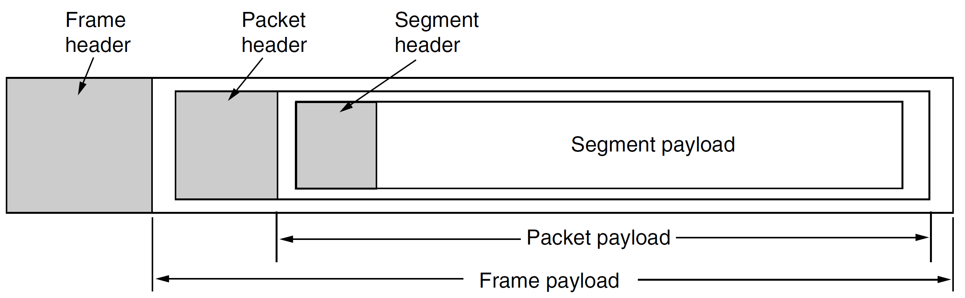
Segment
For lack of a better term, we will use the term segment for messages sent from transport entity to transport entity.
Thus, segments (exchanged by the transport layer) are contained in packets (exchanged by the network layer). In turn, these packets are contained in frames (exchanged by the data link layer).

Slide 34
Data Exchange
When a frame arrives, the data link layer processes the frame header and, if the destination address matches for local delivery, passes the contents of the frame payload field up to the network entity.
The network entity similarly processes the packet header and then passes the contents of the packet payload up to the transport entity.

Slide 35
Client-Server CONNECT Example
The client’s CONNECT call causes a CONNECTION REQUEST segment to be sent to the server.
When it arrives, the transport entity checks to see that the server is blocked on a LISTEN. If so, it then unblocks the server and sends a CONNECTION ACCEPTED segment back to the client.
When this segment arrives, the client is unblocked and the connection is established.

Slide 37
1. View TCP Connections
http://www.nirsoft.net/utils/cports.html
https://docs.microsoft.com/en-us/sysinternals/downloads/tcpview
netstat -ano
taskkill /f /im [pid of the port 8080 got from previous command]
taskkill /f /im 4
net stop srv
net start srv
net stop rdr
net start rdr

Slide 38
2. Use a Network Resource
net use \\192.168.101.110 XDYy4764pgoT /user:Developer1@example.com
SC \\192.168.101.110 Query
SC \\192.168.101.110 Start TermService
net use \\192.168.101.105 /delete

Slide 39
3. Find the Hostname of an IP Address
Login a Domain Controller using an administrative account.
Open cmd.exe
ping -a 192.168.1.60

Slide 40

Thank You & See You Again

